Slide 1




The effect of stadium features on demand for tickets in the Brazilian League
Thadeu Gasparetto
Ángel Barajas
International Conference on Economics of Football
June 23–24, 2017, Kazan, Russia

Slide 2


Presentation Scheme
  Introduction
    Brazilian Stadiums
    Peculiar Situation
    ‘Non-usual stadium’ concept
  Theoretical Background
    Demand for sports
    The impact of stadiums features on tickets demand
    Some current issues
    Research Questions
  Methods
    Data
    Model
  Results
  Conclusions

Slide 3
Introduction

Slide 4
Introduction
  Brazilian Stadiums
    First Division requirement: More than 15,000 seats
      110 stadiums
Source: Guia de Classificação dos Estádios. N = 155
Source: Cadastro Nacional de Estádios de Futebol (CBF, 2016). N = 789.
36% of them have no spotlights

Slide 5
Introduction
  Peculiar Situation
    Around 15% of all Brazilian League matches were played at non-usual stadiums in the last three seasons
      2013: 87
      2014: 62
      2015: 14
    Stadiums under construction – FIFA World Cup 2014
    Some clubs have no their own stadiums
    Using World Cup Arenas after the event

Slide 6
Introduction
  Non-usual stadiums
    Non-usual stadium cannot be interpreted as a neutral site
      Neutral
        Theoretically equal competitive conditions
          Wembley at FA Cup Final
      Non-Usual
        A place where a club has chosen to play due to some particular conditions
          Fans have priority to buy tickets
          The club will sell its proper merchandising
          Carry out other pre-matching services
            Should be considered as home stadium during those matches
  We suppose that non-usual stadiums may have impact on attendance

Slide 7
Theoretical Background

Slide 8
Theoretical Background
  Demand for sports
    Broad Research Line Borland & Macdonald (2003) and García & Rodríguez (2002)
    Consumer preferences
      Day, hour, home-team…
    Economic Factors
      Tickets price, cost of travel, park, foods, opportunity costs, substitutes…
    Quality of Viewing
      Stadium facilities, weather conditions…
    Sporting Contest
      Current performance, sporting success, derby…
    Several different methods have been employed
      Pooled Regressions, Panel Data Regressions, IV, 3SLS, Tobit…

Slide 9
Theoretical Background
Facilities Features
  Consumer Satisfaction
    Service Personnel and Physical Facilities Minor League Ice Hockey Greenwell, Fink & Pastore (2002)
    Physical Facilities Attributes French Ice Hockey Boded and Bernache-Assollant (2009)
  Fans Experience
    Stadium Atmosphere Uhrich & Benkenstein (2010)
  Desire to Stay
    Hospitality and Service Management Professional Golf Watanabe Matsumoto & Nogawa (2013)
  Match Attendance
    Parking, Cleanliness, Food Services Major College Football Wakefield & Sloan (1995)
    Monofunctional Stadium German Bundesliga Feddersen & Maennig (2009)
    Soccer-Specific Stadium Major League Soccer DeShiriver, Rascher & Shapiro (2016)
    Soccer-Specific Stadium Major League Soccer Gómez-González et al. (2016)

Slide 10
Theoretical Background
Recent research lines
  Secondary Market
    Diehl, Drayer & Maxcy (2016)
  Broadcast demand
    Buraimo & Simmons (2015)
  Neutral Sites
    Mirabile (2015)
  There is no paper about demand for tickets at non-usual stadiums
  The impact of stadiums features on professional football’ attendees is unclear

Slide 11
Research Questions
  How a non-usual stadium affect the demand for tickets?
  May the quality of the stadium have impact on attendance as well as tickets price?

Slide 12
Methods

Slide 13
Methods
  Data
    1140 Brazilian League matches 11 games dropped by closed gates
      163 at non-usual stadiums 14.39 % of the total
        3 seasons 2013, 2014, 2015
          No sold out has happened

Slide 14
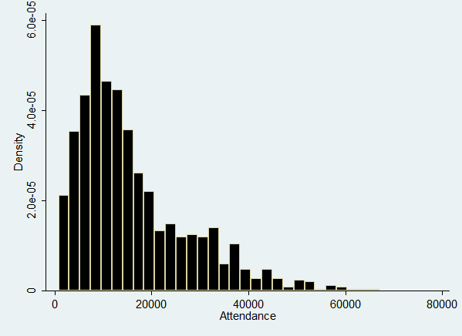
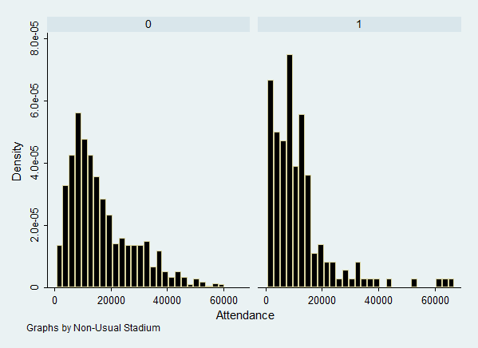
Methods

Slide 15
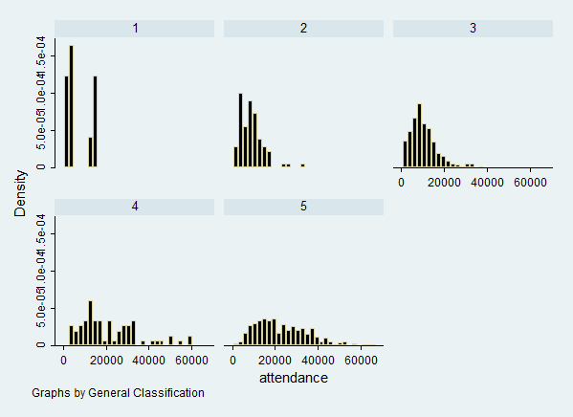
Methods

Slide 16
Methods
Variable | Obs | Mean | Std. Dev. | Min | Max
Attendance | 1129 | 16177.19 | 11556.73 | 766 | 67011
Att_Usual | 966 | 16852.61 | 11457.31 | 1105 | 59482
Att_Non-Usual | 163 | 12174.36 | 11365.29 | 766 | 67011
Real Ticket Price | 1129 | 26.67704 | 14.64659 | 2.7928 | 128.5456
Price_Usual | 966 | 25.7884 | 13.23794 | 2.7928 | 128.5456
Price_Non Usual | 163 | 31.9435 | 20.42578 | 4.637186 | 109.4268
Matchday Revenues | 1129 | 556633.5 | 684040.6 | 9430 | 6948710
Revenues_Usual | 966 | 559474.4 | 641933.8 | 9430 | 5231711
Revenues_Non-Usual | 163 | 539797.1 | 896130.1 | 17650 | 6948710

Slide 17

Methods
  Econometric Approach
    Three-Stage Least Squares Estimator (3SLS) Endogeneity attendance and price
      Home club fixed effects unobserved club-specific effects
      Season fixed effects
    Seven models are estimated to consider some stadium features
    Dependent Variables
      Ln(Attendance)
      Real Ticket Price adjusted by inflation rate
$$\left\{\begin{aligned}\operatorname{Ln}{{\left(Attendance\right)}_{it}}=f (MC_{it}, UO_{it}, SC_{it}) \\ Real Ticket Price_{it}=f (MC_{it}, UO_{it}, SC_{it})\end{aligned}\right.$$

Slide 18
Methods
  Match Characteristics
    Match Quality sum the points divided by the maximum per rounds
    Round and Round²
    Weekday and Saturday Dummies
    Derby match dummy
  Uncertainty of Outcome
    Home win probability and Home win probability² Betting odds
  Stadium Characteristics
    Relative Stadium Capacity Control Variable
    Non-Usual Stadium dummy
    Non-Usual World Cup Arena dummy
    Stadium construction and Stadium construction²
    General Quality
    Security
    Comfort
    Hygiene

Slide 19
Results

Slide 20
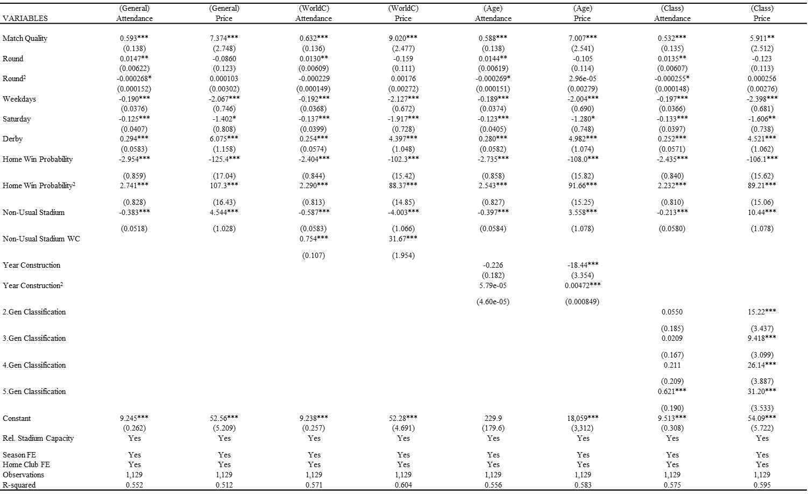
Results

Slide 21
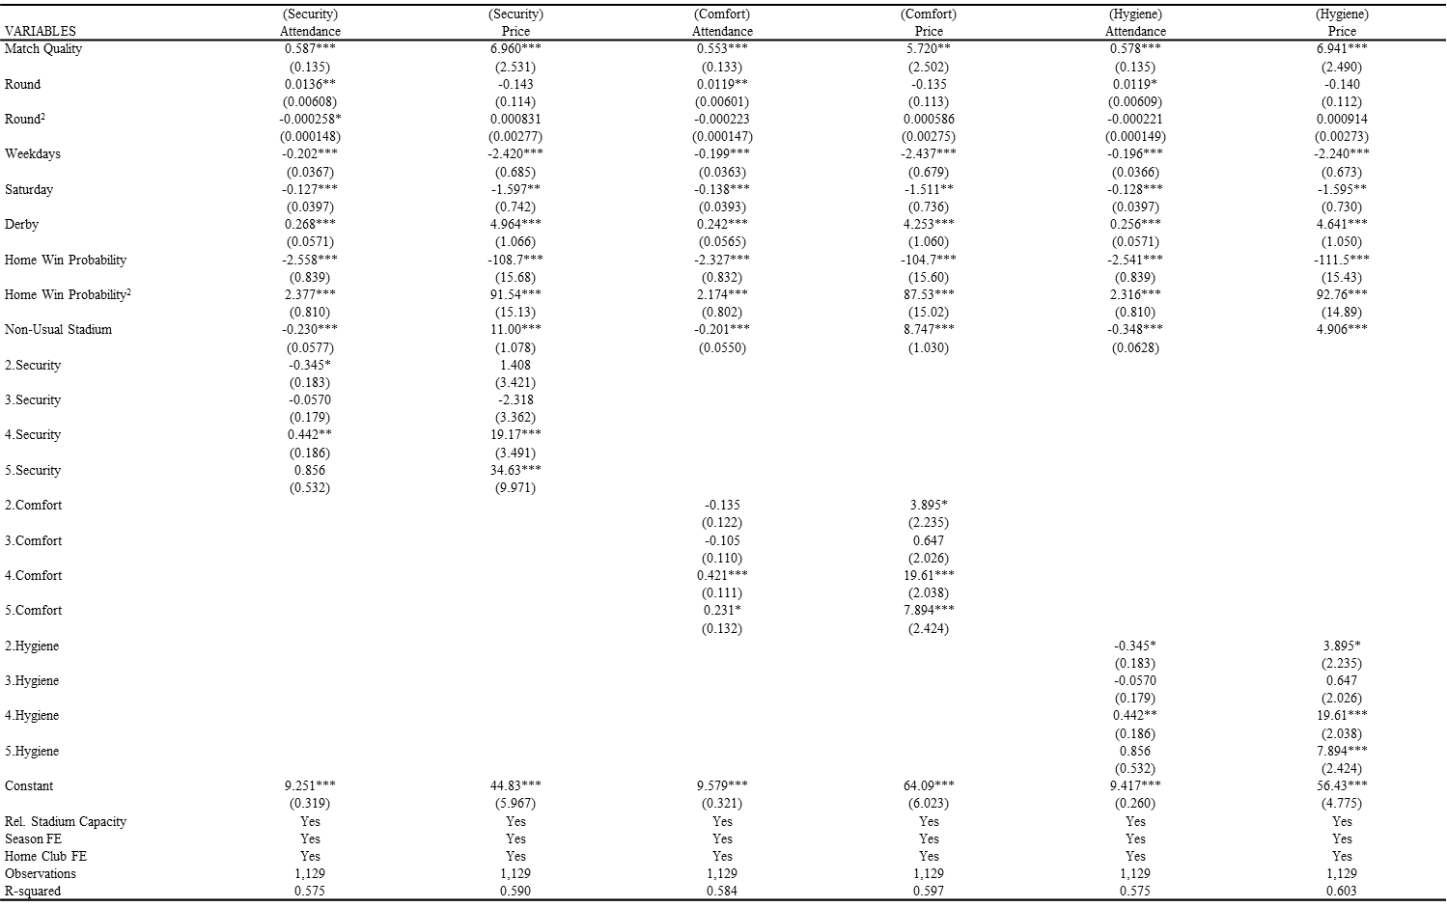
Results

Slide 22
Results

Slide 23
Results
 | (Class) | (Class)
VARIABLES | Attendance | Price
Match Quality | 0.532*** | 5.911**
 | (0.135) | (2.512)
Round | 0.0135** | -0.123
 | (0.00607) | (0.113)
Round² | -0.000255* | 0.000256
 | (0.000148) | (0.00276)
Weekdays | -0.197*** | -2.398***
 | (0.0366) | (0.681)
Saturday | -0.133*** | -1.606**
 | (0.0397) | (0.738)
Derby | 0.252*** | 4.521***
 | (0.0571) | (1.062)
Home Win Probability | -2.435*** | -106.1***
 | (0.840) | (15.62)
Home Win Probability² | 2.232*** | 89.21***
 | (0.810) | (15.06)
Non-Usual Stadium | -0.213*** | 10.44***
 | (0.0580) | (1.078)
2.Gen Classification | 0.0550 | 15.22***
 | (0.185) | (3.437)
3.Gen Classification | 0.0209 | 9.418***
 | (0.167) | (3.099)
4.Gen Classification | 0.211 | 26.14***
 | (0.209) | (3.887)
5.Gen Classification | 0.621*** | 31.20***
 | (0.190) | (3.533)

Slide 24
Results
 | (Security) | (Security)
VARIABLES | Attendance | Price
Match Quality | 0.587*** | 6.960***
 | (0.135) | (2.531)
Round | 0.0136** | -0.143
 | (0.00608) | (0.114)
Round² | -0.000258* | 0.000831
 | (0.000148) | (0.00277)
Weekdays | -0.202*** | -2.420***
 | (0.0367) | (0.685)
Saturday | -0.127*** | -1.597**
 | (0.0397) | (0.742)
Derby | 0.268*** | 4.964***
 | (0.0571) | (1.066)
Home Win Probability | -2.558*** | -108.7***
 | (0.839) | (15.68)
Home Win Probability² | 2.377*** | 91.54***
 | (0.810) | (15.13)
Non-Usual Stadium | -0.230*** | 11.00***
 | (0.0577) | (1.078)
2.Security | -0.345* | 1.408
 | (0.183) | (3.421)
3.Security | -0.0570 | -2.318
 | (0.179) | (3.362)
4.Security | 0.442** | 19.17***
 | (0.186) | (3.491)
5.Security | 0.856 | 34.63***
 | (0.532) | (9.971)

Slide 25
Results
 | (Comfort) | (Comfort)
VARIABLES | Attendance | Price
Match Quality | 0.553*** | 5.720**
 | (0.133) | (2.502)
Round | 0.0119** | -0.135
 | (0.00601) | (0.113)
Round² | -0.000223 | 0.000586
 | (0.000147) | (0.00275)
Weekdays | -0.199*** | -2.437***
 | (0.0363) | (0.679)
Saturday | -0.138*** | -1.511**
 | (0.0393) | (0.736)
Derby | 0.242*** | 4.253***
 | (0.0565) | (1.060)
Home Win Probability | -2.327*** | -104.7***
 | (0.832) | (15.60)
Home Win Probability² | 2.174*** | 87.53***
 | (0.802) | (15.02)
Non-Usual Stadium | -0.201*** | 8.747***
 | (0.0550) | (1.030)
2.Comfort | -0.135 | 3.895*
 | (0.122) | (2.235)
3.Comfort | -0.105 | 0.647
 | (0.110) | (2.026)
4.Comfort | 0.421*** | 19.61***
 | (0.111) | (2.038)
5.Comfort | 0.231* | 7.894***
 | (0.132) | (2.424)

Slide 26
Results
 | (Hygiene) | (Hygiene)
VARIABLES | Attendance | Price
Match Quality | 0.578*** | 6.941***
 | (0.135) | (2.490)
Round | 0.0119* | -0.140
 | (0.00609) | (0.112)
Round² | -0.000221 | 0.000914
 | (0.000149) | (0.00273)
Weekdays | -0.196*** | -2.240***
 | (0.0366) | (0.673)
Saturday | -0.128*** | -1.595**
 | (0.0397) | (0.730)
Derby | 0.256*** | 4.641***
 | (0.0571) | (1.050)
Home Win Probability | -2.541*** | -111.5***
 | (0.839) | (15.43)
Home Win Probability² | 2.316*** | 92.76***
 | (0.810) | (14.89)
Non-Usual Stadium | -0.348*** | 4.906***
 | (0.0628)
2.Hygiene | -0.345* | 3.895*
 | (0.183) | (2.235)
3.Hygiene | -0.0570 | 0.647
 | (0.179) | (2.026)
4.Hygiene | 0.442** | 19.61***
 | (0.186) | (2.038)
5.Hygiene | 0.856 | 7.894***
 | (0.532) | (2.424)

Slide 27
Results
  Highlights
    Match Quality It is a powerful determinant for both Attendance and Tickets Price
    Round and Round² Inverted U-Shape (Attendance) / U-Shape (Price)
    Weekday Decrease around 20% (Attendance) / Decrease around R$ 3.00 (Tickets Price)
    Saturday Dummies Reduce around 13% (Attendance) / Decrease near to R$ 1.50 (Price)
    Derby match dummy Strong positive effect. 25% more attendance and R$ 5.00 expensive tickets
    Uncertainty of Outcome U-Shape Behaviour. Tipping point around 0.46
    Non-Usual Stadium Decrease more than 20% of the demand / Increase tickets price
    World Cup Arena dummy Increase the demand in 75% / Prices growth R$ 31.67
    Stadium construction and Stadium construction² Have no statistical impact
    General Quality Only 5 stars raise the demand (62%) / Every category presents higher prices than 1 star.
    Security 5 stars increase the demand / All categories have expensive tickets
    Comfort 2 Stars reduce; 4 stars increase; 5 stars no effect (Attendance). 4 and 5 stars increase tickets price (5 = R$ 35)
    Hygiene 4 and 5 Stars growth (Attendance) / All categories increase prices

Slide 28
Conclusions

Slide 29
Conclusions
  General Aspects
    Match quality increase both demand and tickets price
    Sunday has higher attendances
    Derby matches attract more fans
  Non-Usual Stadiums
    Decrease the attendance
    Clubs charge expensive tickets there
  Stadiums Features
    World Cup Arenas and 5 stars ones offset the negative effect from Non-Usual stadiums
      Compensate the negative impact and increase attendance around 20% and 40 %
    All Hygiene, Comfort and Security levels are important
      Clubs sell more expensive tickets at those arenas
  Further research
    European football and US Major Leagues
      Estimate the impact to play at non-usual stadiums particular matches
        Cup rounds against small teams often are sold out

Slide 30
Questions, comments and suggestions are welcome
Angel Barajas
abarajas@uvigo.es

