Slide 1
The Influence of Intellectual Capital on Corporate Performance: Evidence from European Companies over the period 2004-2014
PhD Mariia Molodchik
mmolodchik@hse.ru
11.11.2016

Slide 2
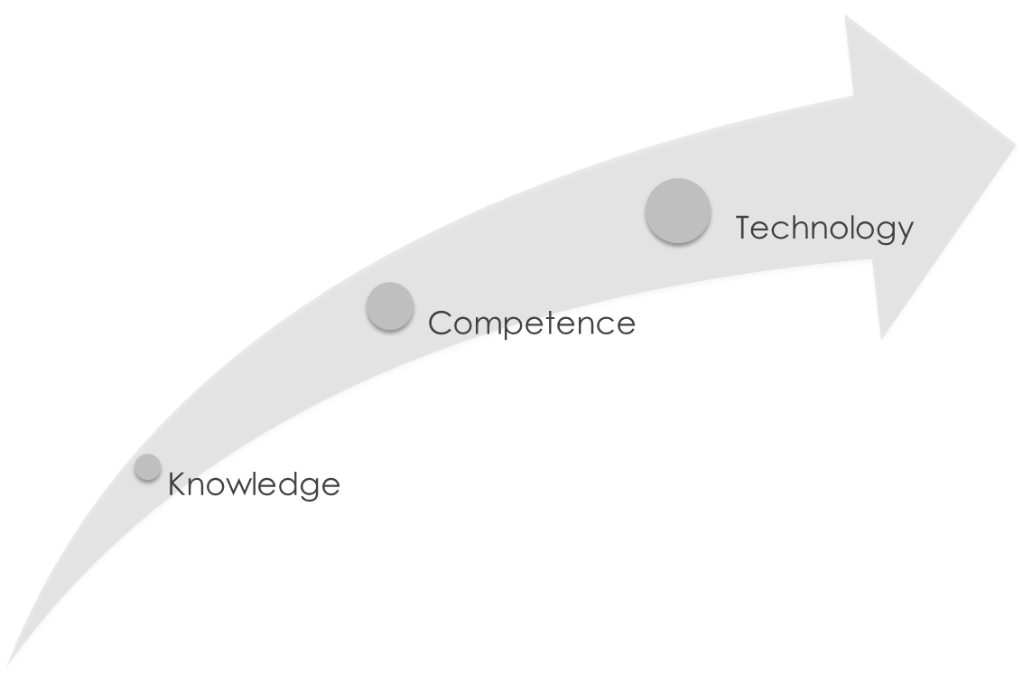
We manage knowledge over full life-cycle of nuclear technology
Documentation
Codes
Information models
Simulators
Databases

Slide 3
International Laboratory of Intangible Driven Economy
IDLAB explores intangible-driven strategic behavior of companies in the new economy and implements networking technologies to develop a geographically and topically distributed research center with three cores.
Petersburg, Russia
Center for studies on large corporations (EU)
Vigo, Spain
Center of studies on Sport economics
Perm, Russia
Center for studies on Russian companies

Slide 4
Research questions
Do intellectual resources have impact on company performance?
Do companies have intangible-intensive profile?
Does intangible-intensive profile allow to outperform generic strategy?

Slide 5
Database
Sources
Bureau Van Dijk (Amadeus) and Bloomberg
Reports and websites of companies
Companies
1700 public companies over the period 2004-2014
Industry
professional, scientific and technical activities (26%), manufacturing (19%), finance and insurance activities (17%), information and communication (10%) and others (28%).
Countries
five European countries: United Kingdom (44%), Germany (24%), France (25%), Spain (5%) and Italy (2%).

Slide 6
How we How we measured intellectual resources? intellectual resource?
HUMAN CAPITAL
STRUCTURAL CAPITAL
RELATIONAL CAPITAL
Human resource capabilities
Productivity
Number of employees
Internal process capabilities
ERP system
KM system
Networking capabilities
Associations
Subsidiaries
Corporate UNI
Brand as employer
Qualification of board of directors
Strategy implementation
Foreign capital
Management capabilities
Qualification of board of directors
Owners-directors ratio
Innovation capabilities
Intangible assets
Patents
Customer loyalty
Brand
Advertising expenditures
Citation in search engines
R&D expenditures
Awards for innovation
Cost of employees
Molodchik, M. A.; Shakina E. A.; Barajas A. (2014) "Metrics for the elements of Intellectual Capital in and economy driven by knowledge", Journal of Intellectual Capital, Vol. 15, No. 2, pp. 206-226.

Slide 7
How we tested hypotheses?
Software: Stata 13
Econometric techniques: principal component analysis, structural equation modelling, 3 stage least square
Econometric specification:
Market value added = f(Economic Value Added, Intangibles, Control variables)
Economic Value Added = f(Intangibles, Control variables)

Slide 8
Results: managers prone to accumulate the resources that are positively recognized by investors
2009
2008
ECONOMIC VALUE ADDED
MARKET VALUE ADDED
Human Resource Cap.
Innovation Capabilities
Customer Loyalty
Int. Process
Capabilities
Sig. positive
Shakina A.; Barajas A.; Molodchik, M. (2017) “Endogenous value creation", Management Research Review, forthcoming.
Networking Capabilities
Sig. negative
Not significant

Slide 9
Results: 2 intangible-intensive profiles are revealed
MANAGEMENT CAPABILITIES
INNOVATION CAPABILITIES
HUMAN RESOURCE CAPABILITIES
INNOVATIVE PROFILE (35%)
CONSERVATIVE PROFILE (37%)
INTERNAL PROCESS CAPABILITIES
CUSTOMER LOYALTY
NETWORKING CAPABILITIES
Shakina A.; Barajas A. (2015) “Intangible intensive profile of a company: the key to outperforming", Journal of Intellectual Capital, Vol.16, Iss.4, pp.721-741 .

Slide 10
Distribution of companies in 3 profiles
(100 quantiles of Market Value Added)
Mean value
Shakina A.; Barajas A. (2016) “Intangible intensive profile of companies: Protection during the economic crisis 2008-2009", Journal of Intellectual Capital, Vol. Iss.4, pp.1469-1930 .

Slide 11
Distribution of companies in 3 profiles
(100 quantiles of Economic Value Added)
Mean value

Slide 12
IDLAB for practitioners: IAS MIRC
Information-analytical system «Monitor of Intangible Resources of Companies» is an open web-source that provides users with information on quantity, quality and efficiency of the intangible resources of public companies and encourages companies to greater disclosure and transparency.
Companies
Self-evaluation
Strategic decisions
Investors
IC disclosure
Decisions
Policy makers
Support policy
Trend analysis

Slide 13
Questions and comments are welcome
Contacts:
Angel Barajas abarajas@uvigo.es (Vigo, Spain)
Elena Shakina eshakina@hse.ru (Sankt-Petersburg, Russia)
Mariia Molodchik, mmolodchik@hse.ru (Perm, Russia)
https://idlab.hse.ru/en/

