Slide 1
Do industry reinforce firm effects for Russian companies? This study comprises research findings from the project №15-18-20039 supported by the Russian Science Foundation.
Carlos M - Fernandez Jardon, University of Vigo (Spain)
Mariia Molodchik, NRU Higher School of Economics (Russia)
Anna Bykova, NRU Higher School of Economics (Russia)
8th October 2016
GSOM2016, SPeterburg, Russia

Slide 2
Motivation
Ongoing debate between two fundamental streams: the resource based view (RBV) and its extensions (Barney, 1991; Sanchez, 1997; Teece, 2010) and industrial organization (IO) (Porter, 1981).
Melville et al. (2007) propose an important research question: "What is the role of industry characteristics in shaping business value?" They also specifically mentioned that the use of industry controls was not a viable means of answering that question.
Despite seeming widespread acknowledgement of the importance of context, such investigations are largely under-explored especially in emerging markets

Slide 3
Previous studies
Ho et al. (2006) found the negative and significant relationship between interaction effects of R&D, and firm and industry characteristics (e.g., R&D x size, R&D x industry concentration) and growth opportunities
Melville, Gurbaxani, and Kraemer, (2007) inserted industry dynamism and competitiveness into their firm-level production functions and observed the positive effect for form capital.
Brito, Carvalho de Vasconcelos (2006) demonstred no significant impact of industry indicators on frim profitability.
Firm’s industry has a significant and sustained impact on its performance (Chang and Singh 2000; McGahan and Porter 2003).

Slide 4
The research framework
Level 2
Industry 1
Industry j
Industry n
Level 1
Firm 1
Firm i
Firm 1
Firm i
Firm 1
Firm i
Firm n
Firm n
Firm n
Relevance of HLM Approach
(Bryk and Raudenbusch 2002).
Notes:
One of the primary advantages of hierarchical linear models is that they allow one to simultaneously investigate relationships within a particular hierarchical level as well as relationships between or across hierarchical levels. In HLM with two levels, each level is represented by its own regression equations. For explanatory purposes, all level-1 indicators are centered on a group mean (group-mean centering) and all level-2 indicators except sector are centered on a grand mean (grand-mean centering).

Slide 5
Issues related with nested data
aggregation bias, when a variable has different meanings at different levels
misestimating of errors, which occur because observations at different levels are not independent
heterogeneity of regression, where relationships between level 1 units differ across level 2 units (Mithas et al. 2006).
In this context, firms (level 1 units) are aggregated (i.e. nested) within industries (level 2 units); the implication here is that within-industry (i.e. across-firm) variation in performance must take into account industry membership.
Standard regression, OLS or otherwise, typically assumes that the association between IT and performance are identical across industries.

Slide 6
The Research Model
Concentration & Localization of Industry
Industry level effects
H1
Intangible assets, Patents
Corporate performance:
EVA
H2
Cross level effects
Firm level effects
Notes:
Does context (i.e., level-2 industry) influence the effect of level-1 firm variables?

Slide 7
Hypotheses
H1: Industry-level factors positively influence corporate performance
Industries with higher concentration & localization levels:
Share the benefits of investment with fewer competitors (Kobelsky et al. 2008)
Have more incentives for innovations and resources for that (Schumpeter 1954)
More concentrated industries by definition have relatively larger firms due larger optimal plant sizes (Curry and George 1983)
Investments in high fixed cost process changing technologies (such as ERP, CRM, etc.) become more feasible due at larger scales.
Implement innovations more efficiently (Wimble et al. 2007)
Are generally able to obtain higher profit margins (Aghion & Jaravel, 2015).
H2: Industry-level factors positively indirectly influence corporate performance through firm-level factors

Slide 8
The Methodology: Random effects model with interaction
Level – 1 (firm):
Level – 2 (industry):
Cross-level
interaction (slope equation):
γ₂₀ reflects the size of interaction (effect on per unit change in IndEf)
Notes:
Level-2 variable IndEf affects slope (B2) of a level-1 FirmEf variable

Slide 9
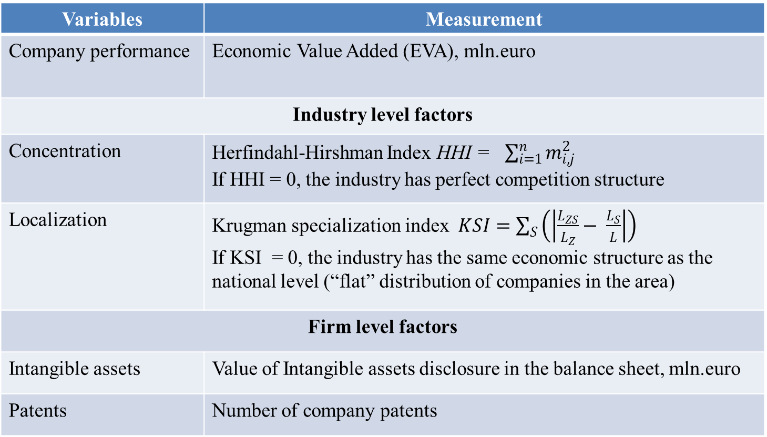
The Variables of Interest
Variables | Measurement
Company performance | Economic Value Added (EVA), mln.euro
Industry level factors
Concentration | Herfindahl-Hirshman Index HHI = $\sum_{i=1}^{n}{m_{i,j}^{2}}$ If HHI = 0, the industry has perfect competition structure
Localization | Krugman specialization index $KSI=\sum_{S}{\left(\left|\frac{L_{ZS}}{L_{Z}}− \frac{L_{S}}{L}\right|\right)}$ If KSI = 0, the industry has the same economic structure as the national level (“flat” distribution of companies in the area)
Firm level factors
Intangible assets | Value of Intangible assets disclosure in the balance sheet, mln.euro
Patents | Number of company patents

Slide 10
The Dataset
The whole sample for the study contains annual data about 1096 public Russian companies from 2004 to 2014, or 12056 firm-year observations.
Proxies for different intangible resources
Industry indicators (concentration, localization) for 32 economic sectors

Slide 11
The Distribution by Industries

Slide 12
Descriptive statistics of the sample
Firm performance by industry sector
33% companies operate in high concentration industries according to HHI
20% firms work on high localized industries according to KSI
Sector | Average EVA | Variance EVA
Agriculture | -4.00 | 14.80
Mining | 505.37 | 1968.60
Manufacture | -10.83 | 130.76
Energy, gas and water production | -45.01 | 344.02
Construction | -11.47 | 46.73
Sale | 1.23 | 31.44
Transport & logistics | -2.17 | 103.82
Other services | 15.84 | 287.31

Slide 13
Results of estimation
Variables | Model 1 (HHI) |  | Model 2 (Loc)
Intercept | -35.134** 15.837 | -35.957 25.630 | -37.961** 14.248 | -44.157** 18.732
Firm level effects:
Intangible assets | -.985*** .104 |  | -.168*** .029
Patents |  | -1.784*** .074 |  | -.674*** .069
Industry level effects:
Concentration | -.003 .006 | -.029*** .010
Localization |  |  | 209.256*** 62.059 | 194.350** 87.807

Slide 14
Results of estimation: cross-level effects
Variables | Model 1 (HHI) |  | Model 2 (Loc)
Intangible assets * Concentration | 4.313*** .098
Patents * Concentration |  | 1.88*** .092
Int. assets* Localization |  |  | 3.096*** .050
Patents*Localization |  |  |  | 1.196*** .094
Time period dummies | Yes | Yes | Yes | Yes
Size | .004*** .001 | .034*** .001 |  | .011*** .001
Age | -.126*** .096 | .116 .152 |  | .032 .136
χ² | 9862.16*** | 2119.79*** | 8153.29*** | 1386.25***
Number of obs | 3680 | 3682 | 8481 | 8299
Number of groups | 32 | 32 | 32 | 32
LR test vs. linear regression (χ²) | 8.12** | 74.42*** | 266.29*** | 383.58***

Slide 15
Results of estimation: Variance decomposition
An intra-class correlation (ICC), which is represented as the ratio of the between group variance to the total variance in IS performance, indicates the amount of total variation that is due to within industry (company level) variation.
ICC= σ²/(σ²+τ)
 | Model 1 (HHI) |  | Model 2 (Loc)
σ² | 121.694 | 1136.276 | 162.741 | 615.186
τ | 64004.06 | 148986.7 | 124027.000 | 203803.400
Across firms | 0,19% | 0,76% | 0,13% | 0,30%
Across industries | 99,81% | 99,24% | 99,87% | 99,70%

Slide 16
Conclusions: direct and indirect effects
The main contribution of our paper lies in the analysis of the direct and the indirect role of and firm performance.
We find that concentration negatively and localization are positively related to EVA.
The indirect effects of industry characteristics and innovation activity are positive, suggesting that industries with abundant resources can increase the benefits provided by innovations, i.e. enhance competitiveness.
High proportion of variance explained by industry (usually it is 10% - 20%)

