Slide 1
Determinants of Performance in eSports
Petr Parshakov, Marina Zavertiaeva
22/07/16

Slide 2
This paper
Rejected
Re-written
Now IJSF: use the same approach as BB2004
Before:
Unit of observation: gamer
Question: Are there country effects (i.e. significant dummies)?
Now:
Unit of observation: country
Question: Determinants of prize by country
Purpose: discuss results, find interpretation?

Slide 3
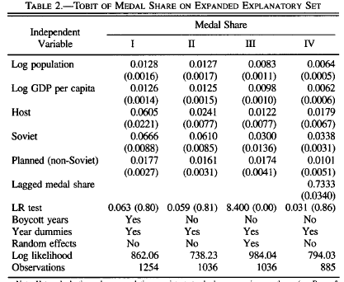
Bernard, Busse 2004

Slide 4
Methodology
Countries with prize – selection?
All – a lot of zeros
Tobit model

Slide 5
FE and RE in Tobit
fixed-effects panel Tobit model is affected by the incidental parameters problem (Neyman and Scott 1948; Lancaster 2000), i.e. the estimated coefficients are inconsistent unless the number of time periods (Ti) approaches infinity for each individual i.
So we use RE with normal distribution

Slide 6
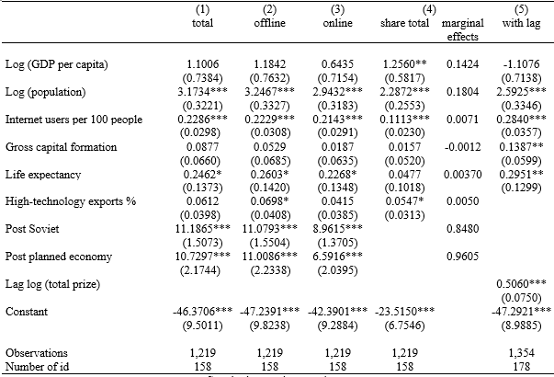
Our results

Slide 7
Marginal effects – log(total prize)

Slide 8
Marginal effects - share

