Slide 1
Investigation of performance gap for Russian FOC and DOC This study comprises research findings from the project №15-18-20039 supported by the Russian Science Foundation.
Carlos M - Fernandez Jardon, University of Vigo (Spain)
Anna Bykova, NRU Higher School of Economics (Russia)
16th June 2016
IFKAD2016, Dresden, Germany

Slide 2
Motivation
“What we need—surprise—is more research.” (Krugman, 2000)
(about studies of FDI influence during the crisis)
The deepest economic crisis since the Great Recession: GDP in industrial countries fell by 4.5 percent while average GDP growth in emerging economies dropped from 8.8 percent in 2007 to 0.4 percent, whereas world trade volume shrimped by over 40 percent, in the second half of 2008 (UNCTAD, 2010).
The growing interest in the research of different aspects of the Global crisis (Eaton et al., 2009; Rose and Spiegel, 2010; Levchenko et al., 2010; Chor and Manova, 2011). Particularly, it grown up the interest of the foreign investments as a significant factor preventing the collapse of global trade.
Few studies attempt to estimate the role of foreign ownership around the economic crisis period on the micro level.
Instead of these uncertain empirical observations, most of the countries continue to pursue policies aimed at encouraging more FDI inflows.

Slide 3
Motivation (cont.)
Russia became one of the three largest recipients in inward FDI amount in 2013 (UNCTAD, 2013).
The dramatic shift of the Russian economy from 2004 to 2014 is an ideal context for examining micro economic responses of foreign ownership to large negative economic shocks.
The investigation of mechanisms smoothing the effect of the crisis is particularly of essential.
Notes:
In emerging economies, external environment plays an important role in firms’ strategic decision-making (Peng et al., 2008).

Slide 4
Previous studies: the lack of consideration
Desai, Foley and Forbes (2008), evaluating the response of multinational and local firms to sharp currency depreciations, and sales, assets, and investments to increase significantly more for U.S. multinational affiliates than for local firms.
Alvarez and Gorg (2007), investigating the response of FOC and DOC to an economic downturn in Chile, do not found multinationals to react to the economic crisis differently than domestic firms.
Tong and Wei (2009) gained that declines in stock prices to be, on average, more severe for manufacturing firms intrinsically more dependent on external finance.

Slide 5
The research framework
Recession
-
Company performance
+
Foreign ownership
+
Controls: size, age, industry, financial leverage, export

Slide 6
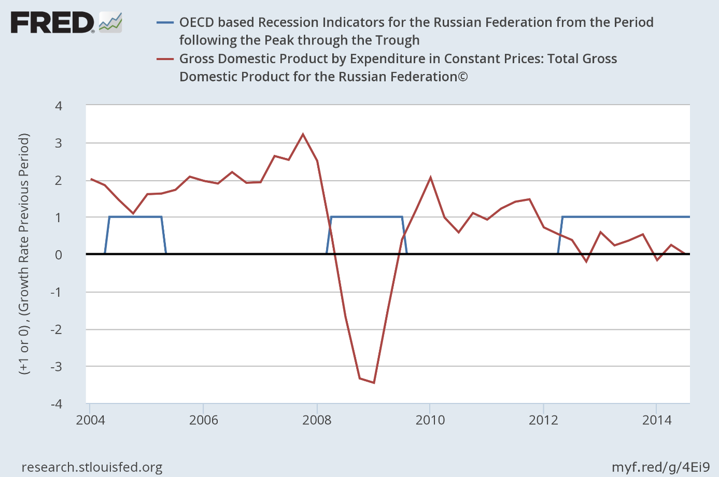
The Recession periods in Russia for 2004-2014 years
2004-2005 – recession (after banking crisis of 2003)
2006 – 2007 – growth (high oil prices and economy boom)
2008-2009 – recession (global economic recession)
2010-2011 – recovery
2012 – 2014 – recession (falling of oil prices, political and economic sanctions)
* estimated through OECD Composite Leading Indicators, "Composite Leading Indicators: Reference Turning Points and Component Series", www.oecd.org/std/cli

Slide 7
The Variables
Variables | Measurement
Company performance | EVA, mln.euro
Recession period | Dummy for Recession period 1/0
Foreign Ownership | Dummy for FO presence 1/0 % of shares belonging to foreign investors, %
Controls
Age | Number of years since the date of establishment, years
Industry | Agriculture, Mining, Manufacturing, Electricity&Gas, Trade, Finance
Financial Leverage | The debt to equity ratio
Size | The number of employees, number of people
Export | Dummy for Export presence 1/0

Slide 8
The Dataset
The whole sample for the study contains annual data about 1096 public Russian companies from 2004 to 2014, or 12056 firm-year observations.
Proxies for different intangible resources
Ownership structure via different types of investors (foreign, private, government and managerial).

Slide 9
The Distribution by Industries

Slide 10
Descriptive statistics of the sample
The share of companies having foreign ownership in our sample equals 26% that is more or less corresponds the situation in Russia economy.
Only 5 and 3 % of analysing companies have block (25-50% of shares) and control (more than 50%) packages, consequently.
Indicators | Descriptive statistics | Whole sample | Foreign ownership | Domestic Ownership | Probability (K-W test)
Number of employees, number | Mean | 4237 | 11108 | 2178 | 0.000
 | St dev | 19375 | 37342 | 7187
 | Number of obs | 9924 | 2289 | 7635
Age, years | Mean | 30 | 25 | 32 | 0.000
 | St dev | 36 | 33 | 36
 | Number of obs | 12056 | 3088 | 8968
Financial leverage | Mean | 2.228 | 1.828 | 2.346 | 0.007
 | St dev | 6.102 | 4.601 | 6.475
 | Number of obs | 9254 | 2112 | 7142
EVA, mln.euro | Mean | -1.845 | -1.779 | -2.112 | 0.019
 | St dev | 12.491 | 15.283 | 11.684
 | Number of obs | 8224 | 1654 | 6570

Slide 11
Descriptive statistics (cont.)
The economic cycle stage | Groups of companies | Number of obs | Mean of EVA, mln.euro | Probability (K-W test)
Recession period | Foreign ownership | 775 | -0.069 | 0.000
 | Domestic ownership | 3212 | -0.078

Slide 12
Model Estimation: Quantile regression for panel data
$$\begin{aligned}EVA_{it}= ∝_{0}+ ∝_{1}Foreign ownership_{it}+∝_{2}Recession_{it}+ \\ ∝_{3}Foreign ownership_{it}∗Recession_{it}+ ∝_{4}Controls_{it}+ε_{it}\end{aligned}$$
The results of the median regression
Recession
-.020***
EVA
PseudoR2 = 0.0223
Number of obs =8523
.011**
Foreign ownership
.002
Controls included
*** - sig at 1%
** - sig at 5%

Slide 13
Model Estimation (cont.) Quantile regression for panel data

Slide 14
Conclusions
Clarification the conflicting evidence founded in the previous papers.
An additional instrument for company managers to increase their competitiveness by implementing the globalization strategy.
The argument for policymaking decisions. In practice, governments spend resources in investment promotion.

Slide 15
Questions & Comments are very welcome!
abykova@hse.ru

