Slide 1
Prize Structure in eSport Tournaments
Dennis Coates, UMBC
Petr Parshakov, NRU HSE

Slide 2
eSport
Competitive video gaming
The global eSports market is worth $748M and will reach $1.9B by 2018 (according to SuperData report)
Team or individual
Dota2, Counter-Strike, StarCraft, WarCraft…
Hamari and Sjöblom (2015, p. 5)
“a form of sports where the primary aspects of the sport are facilitated by electronic systems; the input of players and teams as well as the output of the eSports system are mediated by human-computer interfaces”

Slide 3
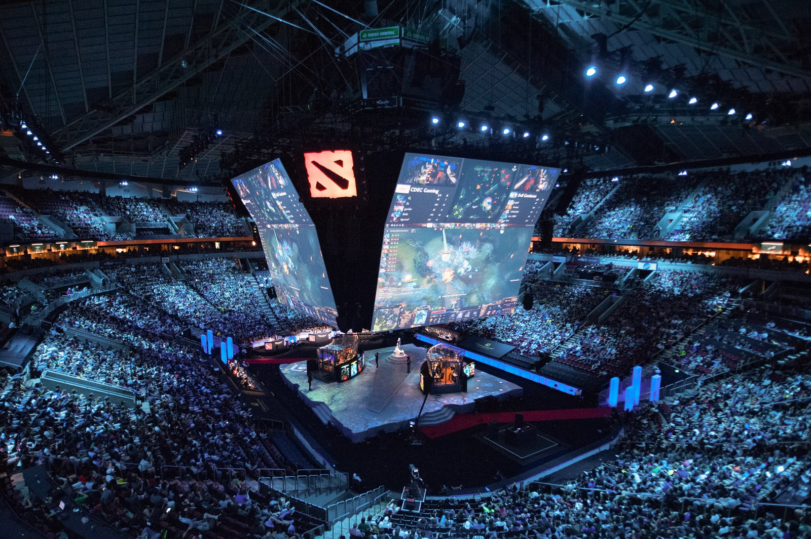
Notes:
Dota 2, seattle, key arena, august 3-9 2015

Slide 4
Question
Does the prize distribution
in eSport tournaments
follows tournament theory?

Slide 5
Tournament theory
Reward structure is based on relative rank rather than absolute levels of output (Lazear & Rosen, 1981)
How NASCAR drivers balance risk taking and crowding as they square off to determine a winner (Bothner, Kang, & Stuart, 2007)
How judges sit on increasingly prestigious courts with the ultimate prize being the U.S. Supreme Court (Choi & Gulati, 2004)
How contract growers vie to supply broiler chickens to Perdue and Tyson (Knoeber & Thurman, 1994)
Explains compensation structures (Messersmith, Guthrie, Ji, & Lee, 2011)
* Based on survey of Connelly, B. L., Tihanyi, L., Crook, T. R., & Gangloff, K. A. (2014).

Slide 6
Effort and prize
The prize designed to maximize effort (Knoeber and Thurman (1994), Moldovanu, Sela and Shi (2007))
Ehrenberg and Bognanno (1990a,b) – Golf
Bognanno (1990) – Bowling
Fernie and Metcalf (1996, 1999), Lynch and Zax (1998) – horseriding
Lynch and Zax (2000), Maloney and McCormick (2000) – foot races
Prinz (1999) – Ironman triathlon

Slide 7
Prize spread optimization
Rosen (1986: 705-706):
the difference in prize (inter-rank spread) for the final stage contestants, relative to the lower stage contestants, should be extraordinarily large
the function describing the relationship between prize and rank is convex

Slide 8
Data: games
 | game | n
1 | StarCraft II | 2849
2 | League of Legends | 1458
3 | Counter-Strike: Global Offensive | 737
4 | WarCraft III | 685
5 | Counter-Strike | 546
6 | Dota 2 | 423
7 | Quake Live | 337
8 | Hearthstone: Heroes of WarCraft | 288
9 | StarCraft: Brood War | 281
28 | Guild Wars 2 | 51

Slide 9
Data: countries
 | Country | Prize
1 | South Korea | 48 873
2 | China | 45 73
3 | USA | 43 396
4 | Singapore | 42 312
5 | Colombia | 40 000
6 | Poland | 32 855
7 | Germany | 31 100
8 | Vietnam | 26 726
9 | Qatar | 26 000
30 | Russia | 10 780

Slide 10
Prize in Dota 2 tournaments

Slide 11
Prizes (team vs individual)

Slide 12
Size and spread of prize

Slide 13
Size and spread of prize
Game type | N | Mean HHI | Mean prize
Individual game | 5,627 | 6,622 | 5,804
Team game | 3,906 | 5,898 | 19,590
Offline tournaments | 24,872 | 3,959 | 27,722
Online tournaments | 39,968 | 7,854 | 2,076

Slide 14
Prize and distribution of prize
* Red line is locally-weighted polynomial regression

Slide 15
Formal test: regression
Lambert et al. (1993) and Conyon et al. (2001)
Dummy for each rank
$log⁡(prize_{ijt})=α+\sum_{j=1}^{7}{β_{j}rank_{j}}+\sum{β_{g}game}++\sum{β_{k}country}+\sum{β_{t}year}+ε_{ijt}$
$$β_{1}≥0$$
$${(β}_{2}−β_{1})≥ β_{1}$$
$${(β}_{3}−β_{2})≥ {(β}_{2}−β_{1})$$
$${(β}_{4}−β_{3})≥ {(β}_{3}−β_{2})$$
$${(β}_{5}−β_{4})≥ {(β}_{4}−β_{3})$$
$${(β}_{6}−β_{5})≥ {(β}_{5}−β_{4})$$
$${(β}_{7}−β_{6})≥ {(β}_{6}−β_{5})$$

Slide 16
Results

Slide 17
Results
 | Team | Individual
Top | 1.89 1.17 0.62 0.43 | 2.04 1.25 0.62 0.55
Low | 1.08 0.31 | 0.97

Slide 18
Results
Prize structure in eSports follows tournament theory
There is a difference between the motivation of groups and individuals
This difference increases along with the reward and the status of the competition

Slide 19
Thank you for your attention!

