Slide 1
Learning and work context as antecedents for innovation behaviour: empirical evidence from Russian companies.
Mariia Molodchik (mmolodchik@hse.ru)
Aleksandra Krutova (alexkrutova@yandex.ru )
Anatoliy Molodchik (rmc@edu.ru)
12.06.2014
IFKAD 2014

Slide 2
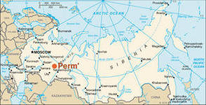
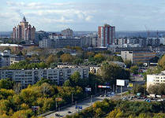
Where are we from?
Russian Federation
Perm region
Board between Asia and Europe

Slide 3
Motivation
The concept of Learning Organization needs practical implementation (Garvin et al., 2008)
Learning positively influences innovation (Senge, 1990; Smith et al. 2008)
Work context is important for learning (Garvin et al. 2008, Holsapple and Sighn, 2002)
Lack of research in developing markets, only few studies in Russian context (Jamali and Sidani (2008)

Slide 4
Research design
Intrinsic motivation
Leadership
INNOVATION BEHAVIOUR
LEARNING
Culture of self-organization
Flexible structure

Slide 5
Hypotheses:
Learning has a significantly positive effect on innovation behaviour.
Work context determines leaning processes.

Slide 6
Methodology
Database collection: survey, Likert scale
Partial Least Square Modelling

Slide 7
Database
95 employees from 15 Russian medium- and large-sized companies.
64% - male and 36% - female.
43% - top-manager; 34% - middle managers; 23% - specialists.
62% of respondents work in the company more than three years.
Manufacturing industry.

Slide 8
Innovation behaviour
In my organization people frequently discuss and initiate the improvement of their work
In my organization people frequently experiment with new ways of working
In my organization people initiate the implementation of new ways of working
In my organization people initiate experiments and development regarding new products or service offerings

Slide 9
Learning
My organization identifies, develops and retains talented employees
In my organization people help each other learn
In my organization people are eager to share information and experience
My organization supports requests for learning opportunities and training
The best practice of one department quickly diffuses within the organization

Slide 10
Intrinsic Motivation
In my organization people are eager to solve new, atypical problems
In my organization people demonstrate the willingness to participate in team-work
In my organization people attempt to achieve best results even to the detriment of personal interests
In my organization people are able to achieve results with minimum external intervention

Slide 11
Leadership
In my organization leaders inspire others to accomplish extraordinary results
Managers encourage multiple points of view
Leaders acknowledge their own limitations with respect to knowledge, information or expertise
Leaders are the example of entrepreneurial and self-development behaviour

Slide 12
Culture of self-organization and self-development
My organization invites people to contribute to the development of strategy
My organization builds alignment of visions across different levels
In my organization learning and self-development are valued
My organization supports and rewards team-work

Slide 13
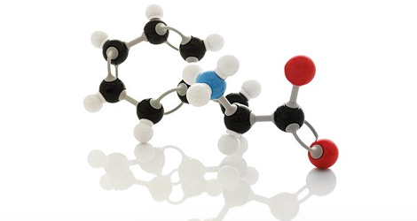
Flexible structure
Organizational structure facilitates more level leadership
New units, departments and projects can be launched quickly
My organization provides resources for innovation initiatives and projects
Clear and transparent regulations support implementation of innovation initiatives

Slide 14
Results:
Intrinsic motivation
0.74
0.44
0.35
Leadership
INNOVATION BEHAVIOUR
(R2=0.75)
LEARNING
(R2=0.71)
0.32
0.48
Culture of self-organization
0.25
Flexible structure

Slide 15
Contribution
Adapting the questionnaire for Russian companies that can encourage future research.
Extending the empirical knowledge of learning organization concept for developing markets.

Slide 16
Acknowledgements:
National Research University Higher School of Economics’
Basic Research Program, ID Lab,
research project «Intangible-driven dynamics in economics and finance»
Project № 02.G25.31.0068 from 23.05.2013 according to resolution of Russian Federation Government № 28 under financial support of Ministry of Education and Science of Russian Federation.

